Slide 1
Arithmetic for Computers
Continue……

Slide 2
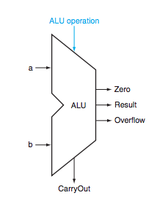
Complete ALU

Slide 3
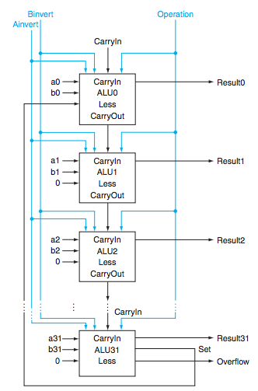
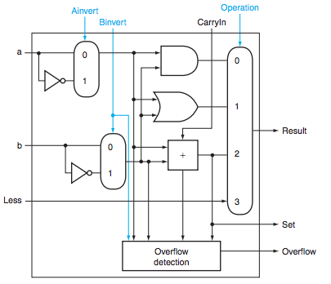

Slide 4
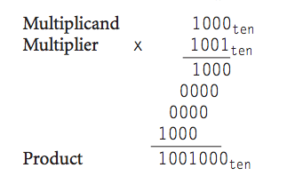
Multiplication
Length of the product is sum of lengths of operands

Slide 5
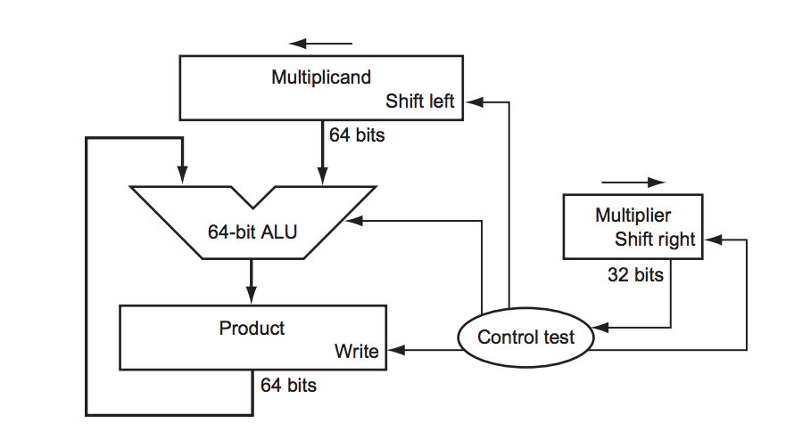
Sequential Version
64
32
64
Initialize 0
Initialized to 0

Slide 6
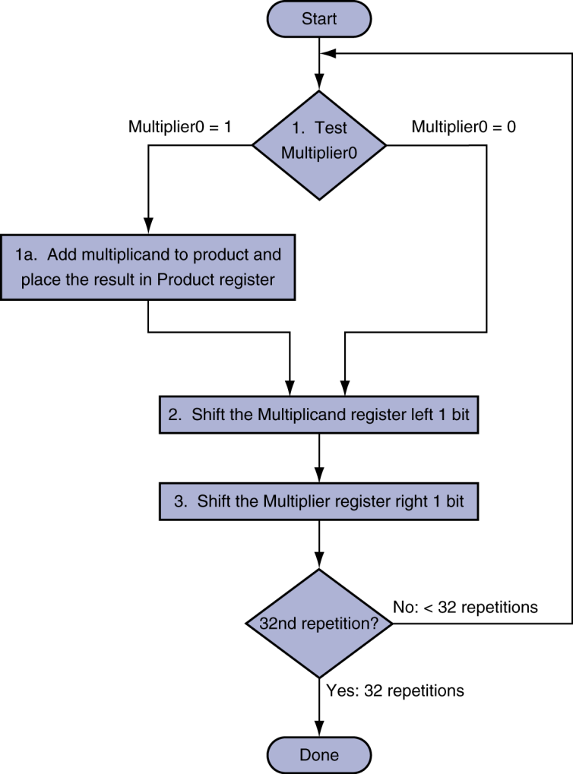
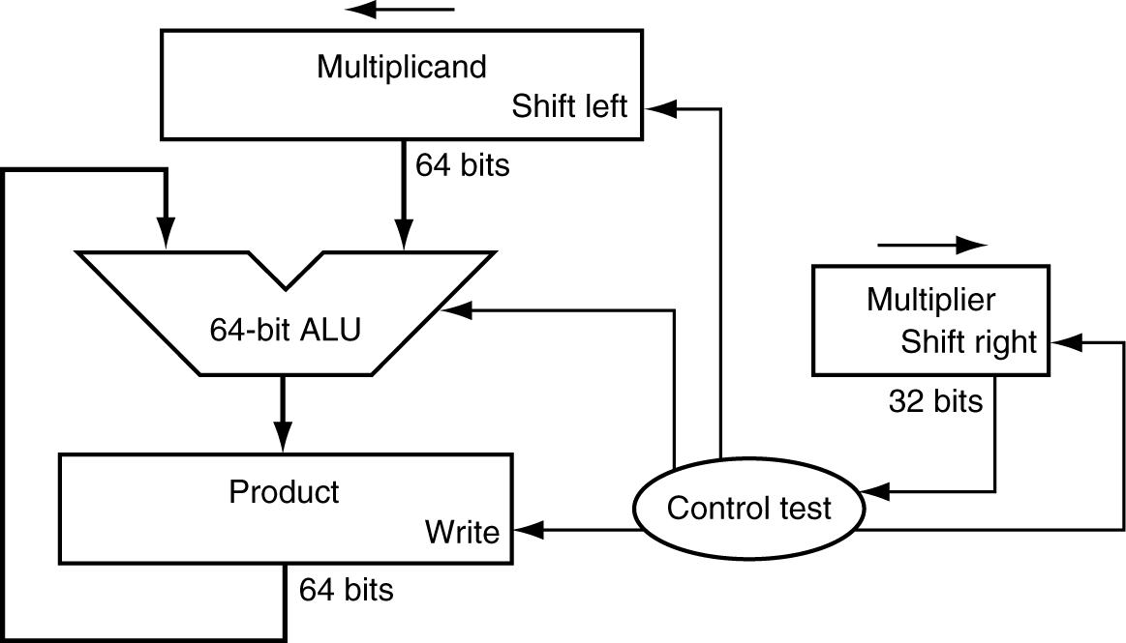
Multiplication Hardware
Initially 0

Slide 7
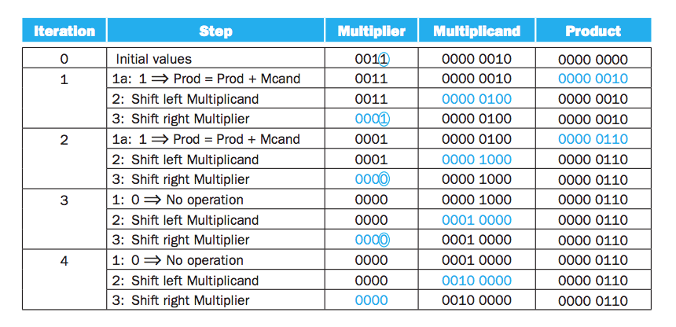
Using 4 bit – 2 X 3

Slide 8
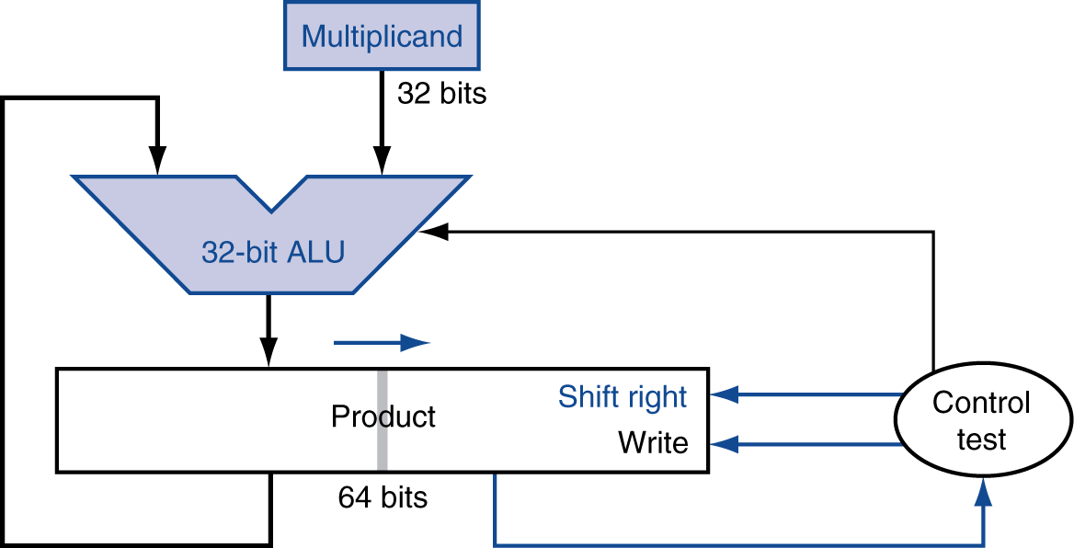
Optimized Multiplier
Perform steps in parallel: add/shift
One cycle per partial-product addition

Slide 9
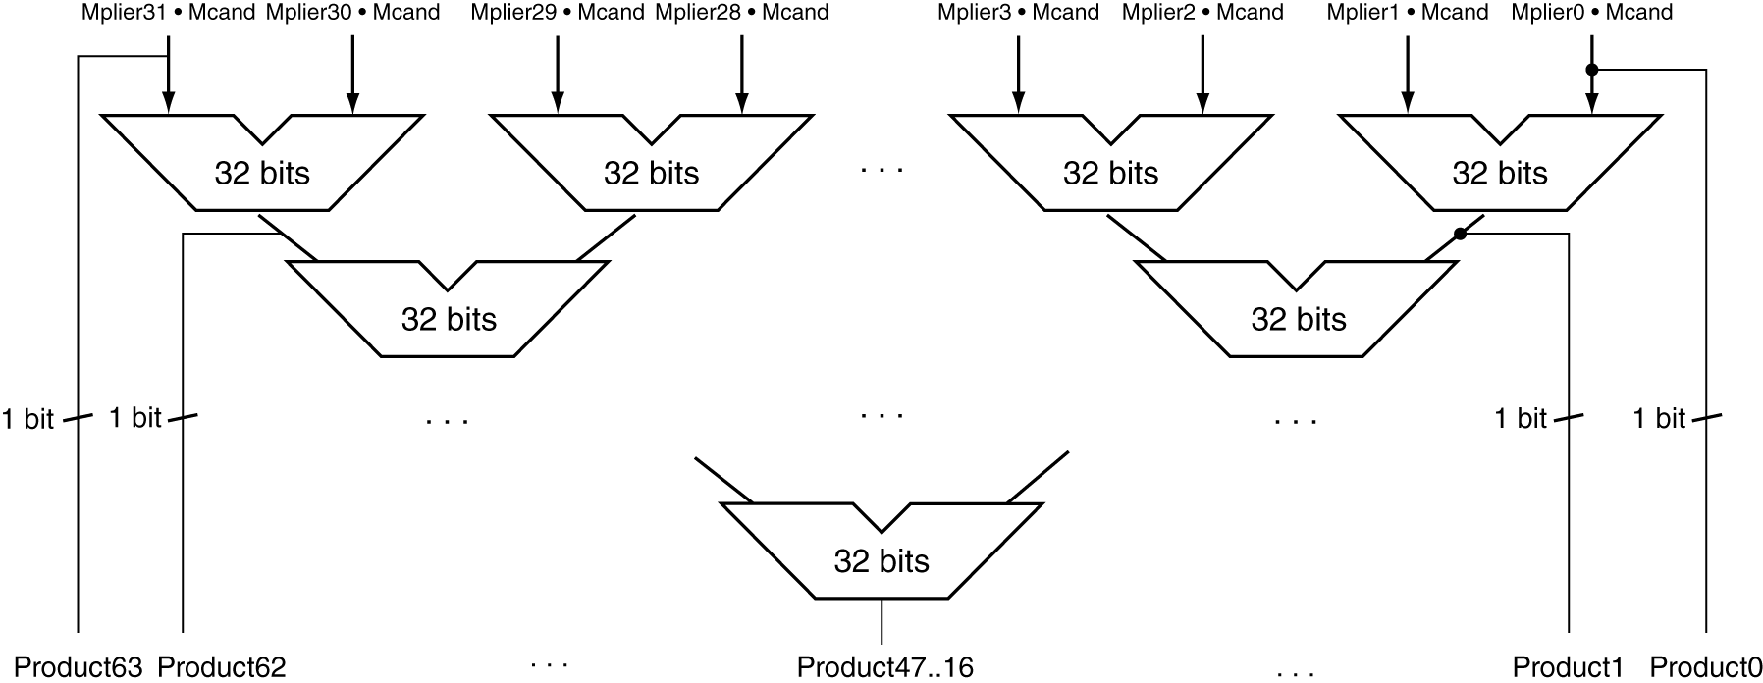
Faster Multiplier
Uses multiple adders
Cost/performance tradeoff
Can be pipelined
Several multiplication performed in parallel

Slide 10
MIPS Multiplication
Two 32-bit registers for product
HI: most-significant 32 bits
LO: least-significant 32-bits
Instructions
mult rs, rt / multu rs, rt
64-bit product in HI/LO
mfhi rd / mflo rd
Move from HI/LO to rd
Can test HI value to see if product overflows 32 bits
mul rd, rs, rt
Least-significant 32 bits of product –> rd

Slide 11
Division
§3.4 Division
Check for 0 divisor
Long division approach
If divisor ≤ dividend bits
1 bit in quotient, subtract
Otherwise
0 bit in quotient, bring down next dividend bit
Restoring division
Do the subtract, and if remainder goes < 0, add divisor back
Signed division
Divide using absolute values
Adjust sign of quotient and remainder as required
quotient
dividend
1001
1000 1001010
-1000
10
101
1010
-1000
10
divisor
remainder
n-bit operands yield n-bit quotient and remainder

Slide 12
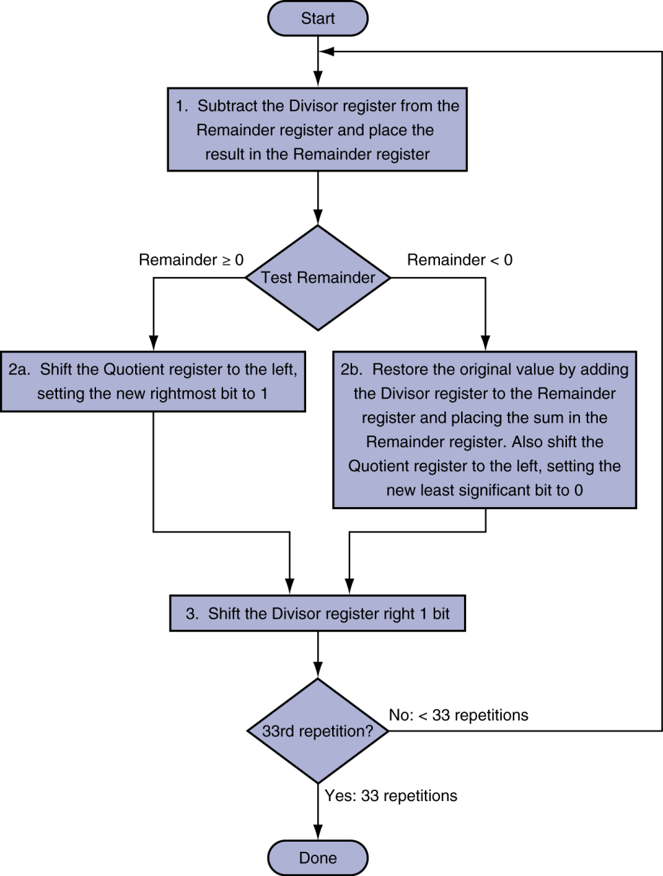
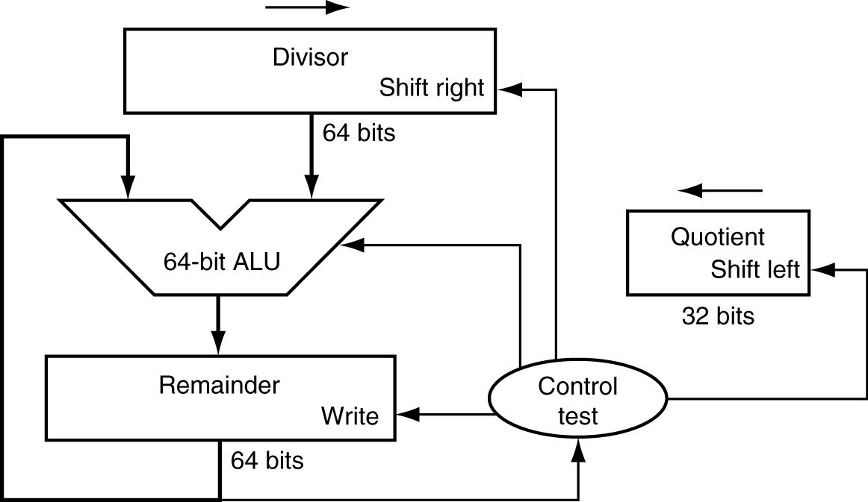
Division Hardware
Initially divisor in left half
Initially dividend

Slide 13
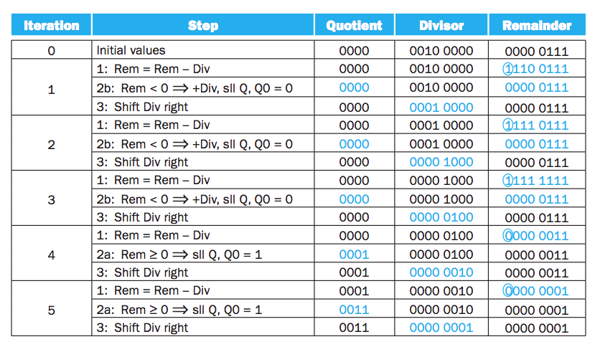
Divide 7 by 2

Slide 14
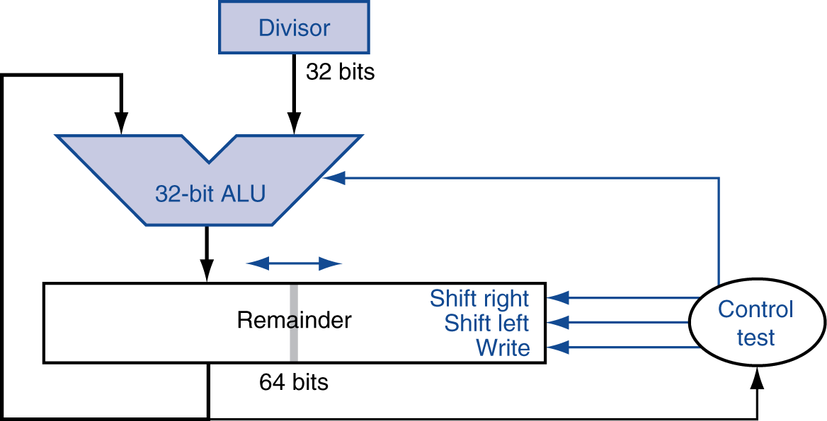
Optimized Divider
One cycle per partial-remainder subtraction
Looks a lot like a multiplier!
Same hardware can be used for both

Slide 15
Faster Division
Can’t use parallel hardware as in multiplier
Subtraction is conditional on sign of remainder
Faster dividers (e.g. SRT devision) generate multiple quotient bits per step
Still require multiple steps

Slide 16
MIPS Division
Use HI/LO registers for result
HI: 32-bit remainder
LO: 32-bit quotient
Instructions
div rs, rt / divu rs, rt
No overflow or divide-by-0 checking
Software must perform checks if required
Use mfhi, mflo to access result

Slide 17
What we have covered?
Sections 3.3 and 3.4

